Slide 1
Experiment Five
The variation in the saturation vapour pressure of water with temperature
Aim:
The purpose of this experiment is to study the variation of the vapour pressure of water with temperature.

Slide 2
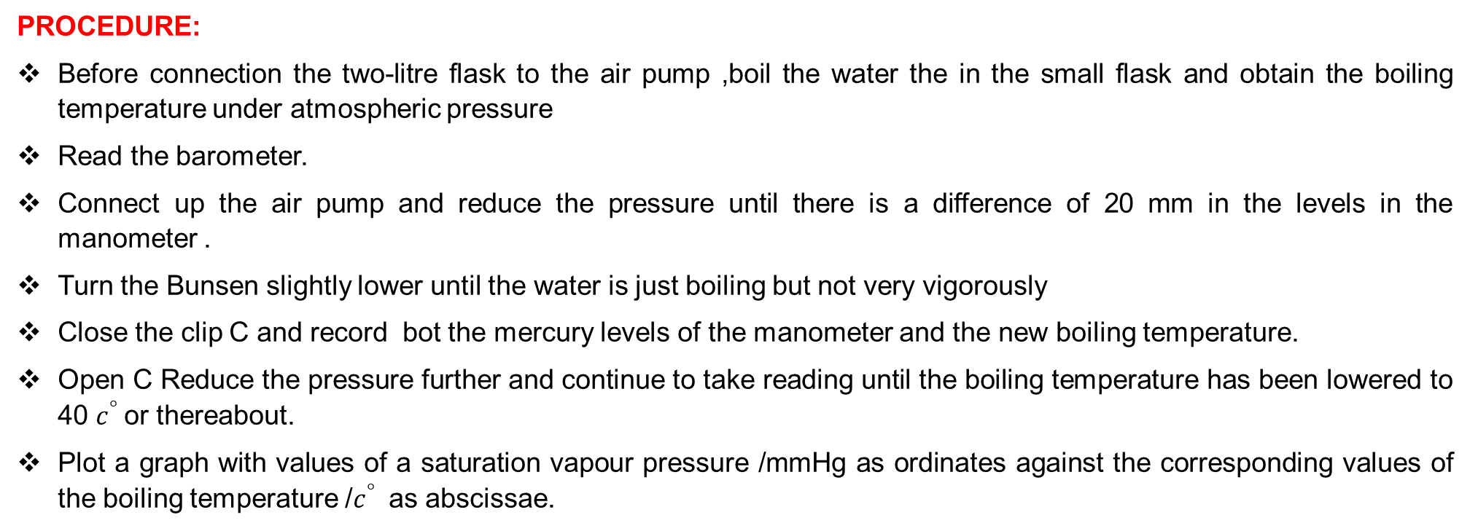
PROCEDURE:
Before connection the two-litre flask to the air pump ,boil the water the in the small flask and obtain the boiling temperature under atmospheric pressure
Read the barometer.
Connect up the air pump and reduce the pressure until there is a difference of 20 mm in the levels in the manometer .
Turn the Bunsen slightly lower until the water is just boiling but not very vigorously
Close the clip C and record bot the mercury levels of the manometer and the new boiling temperature.
Open C Reduce the pressure further and continue to take reading until the boiling temperature has been lowered to 40 $c^{°}$or thereabout.
Plot a graph with values of a saturation vapour pressure /mmHg as ordinates against the corresponding values of the boiling temperature /$c^{°}$ as abscissae.

